Slide 1
McKinsey’s Take on Operational Excellence
McKinsey’s modern view of Operational Excellence has evolved far beyond Lean, Six Sigma, and classical productivity programs. Their newest publications describe Next‑Generation OpEx as a technology‑enabled, human-centered, end‑to‑end operating system designed to make organizations faster, smarter, more resilient, and capable of continuous reinvention.

Slide 2
Why Operational Excellence Matters Now (McKinsey Perspective)
According to McKinsey (2024–2025 insights), companies face:
Macroeconomic pressures
Supply chain disruptions
Climate commitments
Rising customer expectations
Talent shortages
Survival now requires:
Learning and adapting faster
Rethinking assumptions
Using digital, analytics, AI, robotics intelligently
Even though companies have invested heavily in tech, productivity has not grown proportionally, which McKinsey attributes to:
Loss of operational discipline
Missing frontline capabilities
Tech being layered “on top” of old processes instead of redesigning processes end-to-end

Slide 3
McKinsey’s Definition of “Next-Generation Operational Excellence”
McKinsey describes modern OpEx as:
A renewed, expanded operating philosophy that integrates continuous improvement with digital, analytics, AI, robotics, and human capability building—across all functions.
Essentially, OpEx is no longer a manufacturing-only program.
It’s an enterprise capability linking
strategy → operations → culture → technology.

Slide 4
McKinsey’s 5 Core Elements of Operational Excellence
McKinsey’s “Next‑Generation Operational Excellence” approach states that OpEx consists of 5 core elements (from the McKinsey Operations Practice). While the source doesn’t list the five elements directly in the snippet, McKinsey typically defines them as:
1) Strategy & Purpose Alignment
Operations must be united with mission, values, financial goals, and enterprise strategy.
2) Lean Foundations & Operational Discipline
McKinsey emphasizes rediscovering foundational Lean/CI discipline lost during rapid crises.
3) Digitization, Analytics, & AI at Scale
Companies must embed digital—not bolt it on—to transform flow, predictability, decisioning.
4) Talent, Skills, & Cultural Adoption
OpEx requires capability building, frontline empowerment, and new workforce models.
5) End-to-End Reinvention of Processes
Front-to-back redesign across supply chain, manufacturing, customer operations, and shared services.
These form McKinsey’s modern OpEx “operating system.”

Slide 5
McKinsey’s Insight: Why Traditional OpEx Fails
McKinsey strongly highlights that most traditional productivity programs fail because:
✔ Technology is grafted onto old processes, not redesigned
✔ Operational discipline deteriorated after COVID—loss of tacit knowledge
✔ Companies automate chaos instead of removing it
(McKinsey calls this false or “shallow” digitization.)
✔ Improvements are not linked to enterprise purpose

Slide 6
What High-performing Companies Do Differently (McKinsey Research)
From the “Next‑Generation Operational Excellence Survey” of 1,000+ employees:
Top performers:
  1) Build tech-enabled, end-to-end operations
  2) Maintain high operational discipline
  3) Institutionalize continuous learning
  4) Empower frontline with digital tools
  5) Create agile/lean hybrid operating models
  6) Prioritize resilience and adaptability
  These companies achieve year‑over‑year gains in:
  Productivity
  Time to market
  Customer satisfaction
  Employee engagement

Slide 7
McKinsey’s “Rewiring for Productivity” View
The October 2024 McKinsey research outlines that to achieve true OpEx-driven productivity:
✔ Organizations must “rewire”
This includes:
Resetting talent models
Embedding tech directly into workflows
Rebuilding lost standard work
Reestablishing frontline routines
✔ Productivity stagnation has micro-level causes
(frontline disruptions, turnover, lost knowledge).

Slide 8
McKinsey’s Operational Excellence Framework (Strategic Overview)
A. Foundation
Culture of continuous improvement
Leaders driving accountability & innovation
Strategic alignment (Hoshin-style)
B. Strategic Alignment
SMART goal setting
Tying operational KPIs to business objectives
Regular KPI review & course correction
C. Process Optimization
Lean
Six Sigma
Waste elimination
Variability reduction
(Explicitly emphasized in McKinsey’s framework.)
D. Technology Enablement
Digital
Automation
Analytics
Data-driven decisions
E. People & Capability Building
Empowerment
Upskilling
Role clarity

Slide 9
McKinsey’s View on Technology Inside OpEx
McKinsey’s 2024 and 2025 insights repeatedly emphasize:
✔ GenAI adoption accelerating decision quality
One-third of survey respondents use GenAI regularly; 40% increased AI investments.
✔ Robotics + automation create new operating models
Industrial robotics projected to grow 10% annually through 2030.
✔ Technology must be embedded into processes
Not added as “patchwork.”
McKinsey’s Human-Centric (Culture) View
McKinsey research stresses:
✔ High performers have strong culture and frontline capability
✔ Leaders must set expectations & empower teams
✔ Knowledge loss after COVID must be reversed

Slide 10
McKinsey’s Guidance on End-to-End Operational Excellence (E2E)
McKinsey says that OpEx is no longer a collection of tools—it must cover all functions:
Manufacturing
Supply chain
Customer operations
GBS & enterprise services
R&D
Procurement
Order-to-cash
Planning
E2E OpEx enables:
Faster flow
Fewer silos
Stable performance
Lower cost
Better service
And integrates:
Lean
Agile
Digital

Slide 11
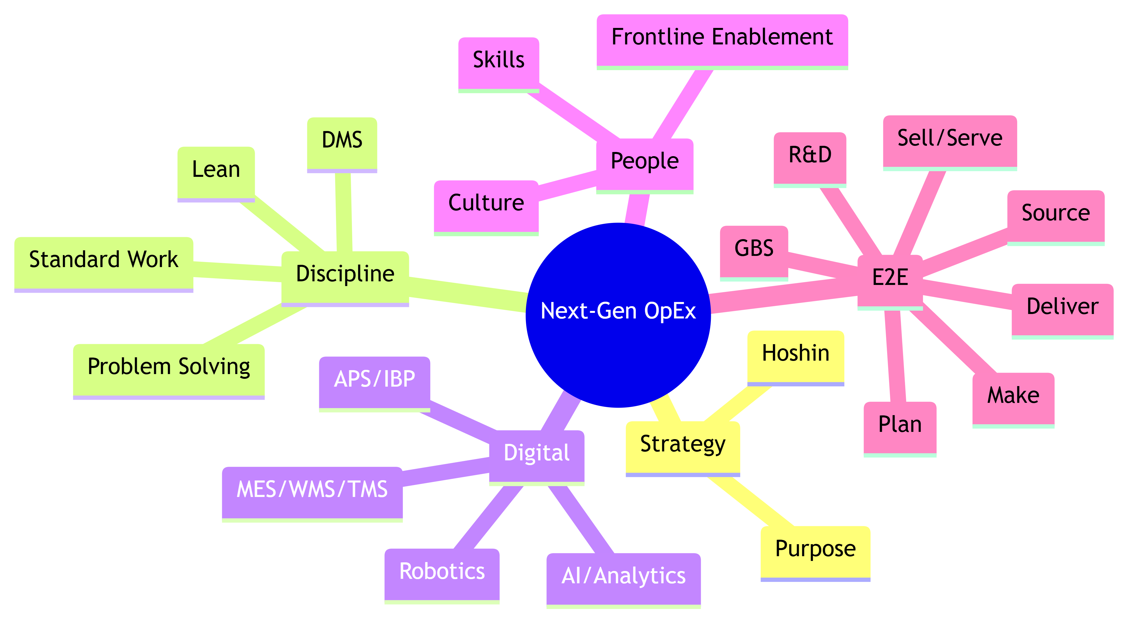

Slide 12
Final Summary of McKinsey’s View
McKinsey’s modern OpEx =
Lean + Continuous Improvement + Digital + AI + Human Capability + End-to-End Reinvention.
The focus is on:
Linking operations directly to strategy
Rebuilding operational discipline
Scaling digital & AI into daily workflows
Empowering frontline & restoring knowledge
End-to-end process redesign, not isolated improvements
Creating resilience and adaptability as a competitive edge

Slide 13
Quick‑Start Rollout Plan (30/60/90) — McKinsey Style
Days 0–30 — Diagnose & (Re)Establish Discipline
Hoshin: clarify 2–3 enterprise outcomes (e.g., +5 pts OEE, +3 pts OTIF, −10% cost‑to‑serve).
Stand up tiered DMS; restore standard work on 2 pilot value streams (1 plant line, 1 O2C flow).
Loss tree/Pareto; baseline digital use; identify “decision moments” for AI.
Days 31–60 — Redesign & Embed Tech in Flow
SMED + AM/PM package for the constraint line; daily S&OE for OTIF.
Embed APS/short‑term planning, MES/WMS telemetry; gen‑AI copilot for order exceptions.
Capability sprints for frontline; operator‑led problem solving.
Days 61–90 — Scale & Lock‑In
Extend to 2–3 more value streams; codify playbooks; launch academy.
Benefits tracking, control charts; quarterly Hoshin review; portfolio to scale AI/automation.

Slide 14
Core Principles of :
GE Healthcare’s Framework
A. Integration of People, Process, Technology (PPT)
GE Healthcare emphasizes that healthcare systems fail when people, processes, and technology operate in silos. Their operating philosophy:
Diagnose fragmentation → unify workflows → create system‑wide alignment
Integration enables:
  operational efficiency
  workflow simplification
  reduction of friction
  better clinical outcomes
This “integration model” is positioned as the foundation for operational excellence in healthcare systems.
Danaher Business System framework
A. DBS = “Who we are and how we do what we do”
DBS guides planning, daily management, kaizen, execution, and leadership.
It is built around 3 pillars:
  Growth
  Lean
  Leadership
  DBS is described as Danaher’s long‑term competitive advantage.

Slide 15
Dimension | GE Healthcare | Danaher (DBS)
Core Philosophy | Integration + governance + Lean for healthcare | Lean + Growth + Leadership
Roots | GE’s Lean Six Sigma heritage + healthcare workflow science | Toyota-style Lean adapted over 35 years
Operating System | No single branded OS, but structured Lean governance & hospital transformation | DBS (full operating system)
Governance | Strong governance frameworks for alignment | Hoshin, daily management, DBS office
Kaizen | Present, but less formalized | Deep institutional Kaizen engine
Digital Ops | AI scheduling, OR workflow, enterprise integration | AI adoption, flow optimization, analytics embedded in DBS
Culture | Leadership, capacity, staff satisfaction focus | “Best Team Wins”, talent cultivation
Breadth | Hospital systems, clinical workflow, supply chain | Manufacturing, R&D, sales, marketing, supply chain

Slide 16
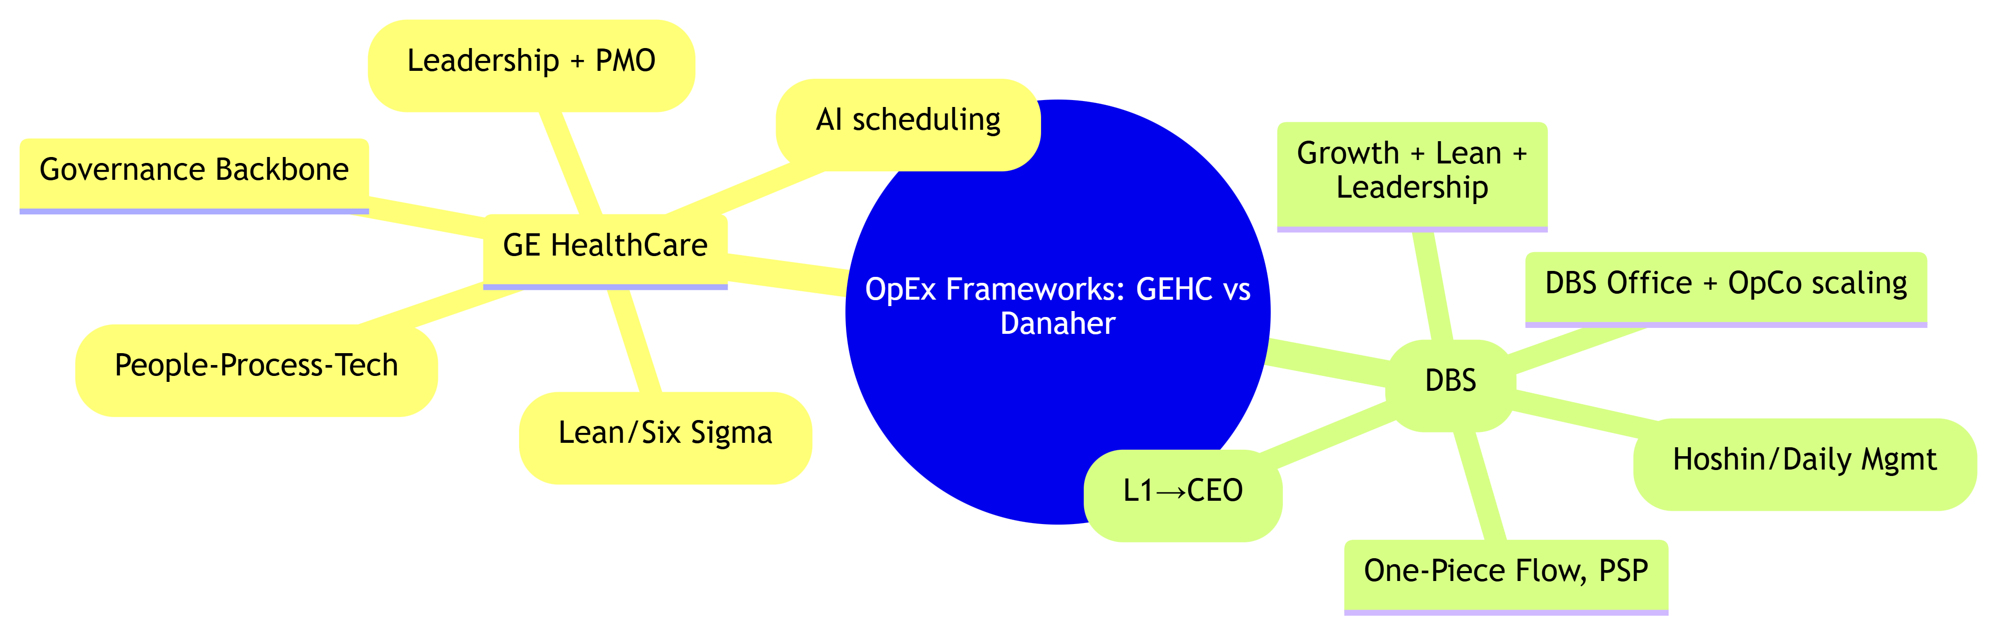

Slide 17
